Slide 1

Early Diabetes Prediction and Intervention Using Machine Learning
A Hackathon Project by Yuchen Ma
08/16/2024

Slide 2

Agenda
Business Problem
Approach
Outcome
Conclusion

Slide 3

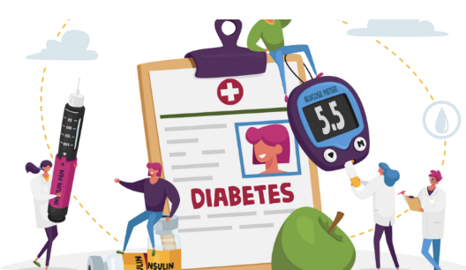
Business Problem
Diabetes as a Health Challenge
Diabetes is a major global health challenge, costing $412.9 billion in the U.S. in 2022, making early intervention crucial for reducing costs and improving outcomes
Importance of Predictive Modeling
Machine learning models predict diabetes risk, supporting early intervention and aligning with value-based care that prioritizes outcomes over service volume
Project Objective
The goal is to create a predictive model to identify high-risk individuals for diabetes, enabling timely interventions and informed, data-driven decisions to improve outcomes and reduce costs.

Slide 4




Approach Summary
Data understanding
Modeling
Cross Validation
Model Evaluation
Data Cleaning
EDA process
Logistic model
Classification Tree
LASSO model
5-fold cross validation
Key metrics:
Accuracy
Precision
Recall
F1-Score

Slide 5


Model Selection
CART: highest accuracy, perfect precision, lower recall
ideal for minimizing false positives
may miss some cases
Logistic & Lasso: balanced precision and recall
better for detecting positive cases while controlling false positives
Outcome
Model | Accuracy | Precision | Recall | F-1 Score
Logistic | 95.9% | 86.03% | 63.53% | 73.09%
CART | 97.16% | 100% | 67.59% | 80.66%
LASSO | 95.91% | 86.31% | 63.42% | 73.11%

Slide 6



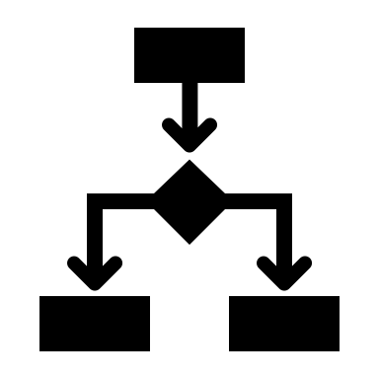


Opportunities & Limitations
Limitations & Future Work
Cost saving
Decision making
Misclassification
Data Privacy
Potential cost savings through early intervention and resource optimization
Integration of the predictive model into healthcare systems for real-time decision-making
Misclassification could lead to unnecessary interventions or missed cases, impacting patient health
Data privacy and compliance with healthcare regulations must be strictly maintained

Slide 7
Integrating machine learning techniques in healthcare enables pattern recognition and decision-making, effectively addressing the critical business need for early diabetes detection
Investigate advanced machine learning models like Random Forests to enhance predictive accuracy
Implement the model in clinical settings and refine it based on feedback and real patient data
Regularly monitor and update the model to maintain accuracy and adapt to evolving healthcare needs
Conclusion

Slide 8


Thank you!
Any Questions?

